Slide 1
Developing Kafka Applications – Producer API

Slide 2


What is a Producer?
Producer
Producers produces the data sent to the Kafka clusters
Sent via topics
Directly involved in load-balancing
Controls the resiliency of messages

Slide 3
Kafka APIs
Kafka ships with built in client APIs for developers to use with applications
Kafka ships with a Java client that is recommended
Legacy Scala clients are still included
Kafka also includes a binary wire protocol
Many tools in other languages that implement this wire protocol

Slide 4
The Java API
Generic sender where:
K = Type of key
V = Type of message
org.apache.kafka.clients.producer
Constructor takes a configuration (mostly a hashmap of options)
KafkaProducer<K,V>
Send a messages (with or without callbacks)
KafkaProducer(config: Properties) send(ProducerRecord<K,V>): Future<RecordMetaData>
send(ProducerRecord<K,V>, Callback): Future<...>
flush()
metrics(): Map<MetricName, ? extends Metric>
close()
Get metrics for this producer

Slide 5
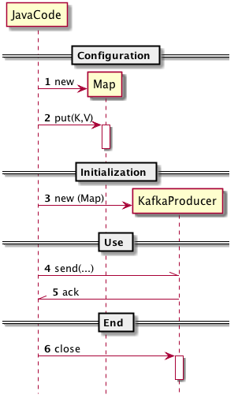
Java API Behavior
// Configuration
Properties kp = new Properties();
kp.put("bootstrap.servers",
"mybroker1:9092,mybroker2:9092");
kp.put("key.serializer", "...");
// Initialization
KafkaProducer<String, String> producer =
new KafkaProducer<String, String>(kp);
// Use
Future<...> f = producer.send(...);
... f.get(); // when acked
// End
producer.close();

Slide 6
The ProducerRecord
Generic record where:
K = message key
V = Type of message
org.apache.kafka.clients.producer
ProducerRecord<K,V>
Messsage Key is optional
key: K
value: V
topic: String
partition: Integer
Partition Key is optional
ProducerRecord(topic: String, partition: Integer, key: K, value:V) ProducerRecord(topic: String, key: K, value: V) ProducerRecord(topic: String, value: V)

Slide 7
Sending a Message
ProducerRecord<String,String> record =
new ProducerRecord<String,String>(
"someTopic", "someKey, "someValue");
producer.send(record, new Callback() {
public void onCompletion(
RecordMetadata metadata, Exception e) {
if(e != null) e.printStackTrace();
System.out.println(
"Offset: " + metadata.offset());
}
});

Slide 8
Diverse Use Cases – Different Optimal Uses
Sending messages to Kafka can cover a wide set of use cases
Recording user activities for auditing or analysis
Recording metrics
Storing log messages
Recording information from smart appliances
Asynchronous communication with other applications
Buffering information before writing to a database
Each use case may require a different behavior when publishing data to Kafka

Slide 9
Diverse Requirements
All messages are not created equally!
Is every message critical or is message loss tolerated?
Are duplicate messages ok?
Are there strict latency or throughput requirements?

Slide 10
Credit Card Transaction Scenario
Suppose you have an online store where the following happens:
The first system sends each transaction to Kafka immediately when a payment is made
Another system sends an approval/denial message to Kafka for the credit card after analyzing the request for fraud, suspicious behavior, etc.
A third application reads both transaction and approval status and stores them in a database for later analysis

Slide 11
Kafka Requirements for Credit Card Transactions
What is important for Kafka in the previous example?
Never lose a single message
No duplicate messages
Latency should be low but up to 0.5 seconds can be tolerated
Throughput should be high – expect to process up to a million messages per second

Slide 12
Storing Click Information From a Website
Consider an entirely different use case of storing click information from a website to track user behavior
What are the Kafka requirements?
Some message loss a few duplicates can be tolerated
Latency can be high as long as it does not impact user experience
Throughput depends on the website traffic

Slide 13
Producer API
Different use case requirements will influence the way the producer API is used to write messages to Kafka and its configuration
Three primary ways of sending messages
Fire-and-forget – send a message and don't really care if it arrived successfully or not. Most of the time it will arrive successfully but it's possible that some messages will get lost
Synchronous send – message is sent and a Future object is returned which can be used to see if the send() was successful
Asynchronous send – the send() method has a callback function which is triggered when a response is received from the Kafka broker

Slide 14
Acknowledgement of Messages
No ack (0)
Kafka will most likely receive the message
Producer will not wait for any reply from the broker before assuming the message was sent successfully
If something goes wrong, producer will not know and message is lost
Because producer is not waiting for a response, high throughput can be achieved
Ack from N replicas (1..N)
A message is not considered consumed by the Kafka cluster unless N replicas holding the message has acknowled
Ack from all replicas (-1)
Every replica must acknowledge the message

Slide 15
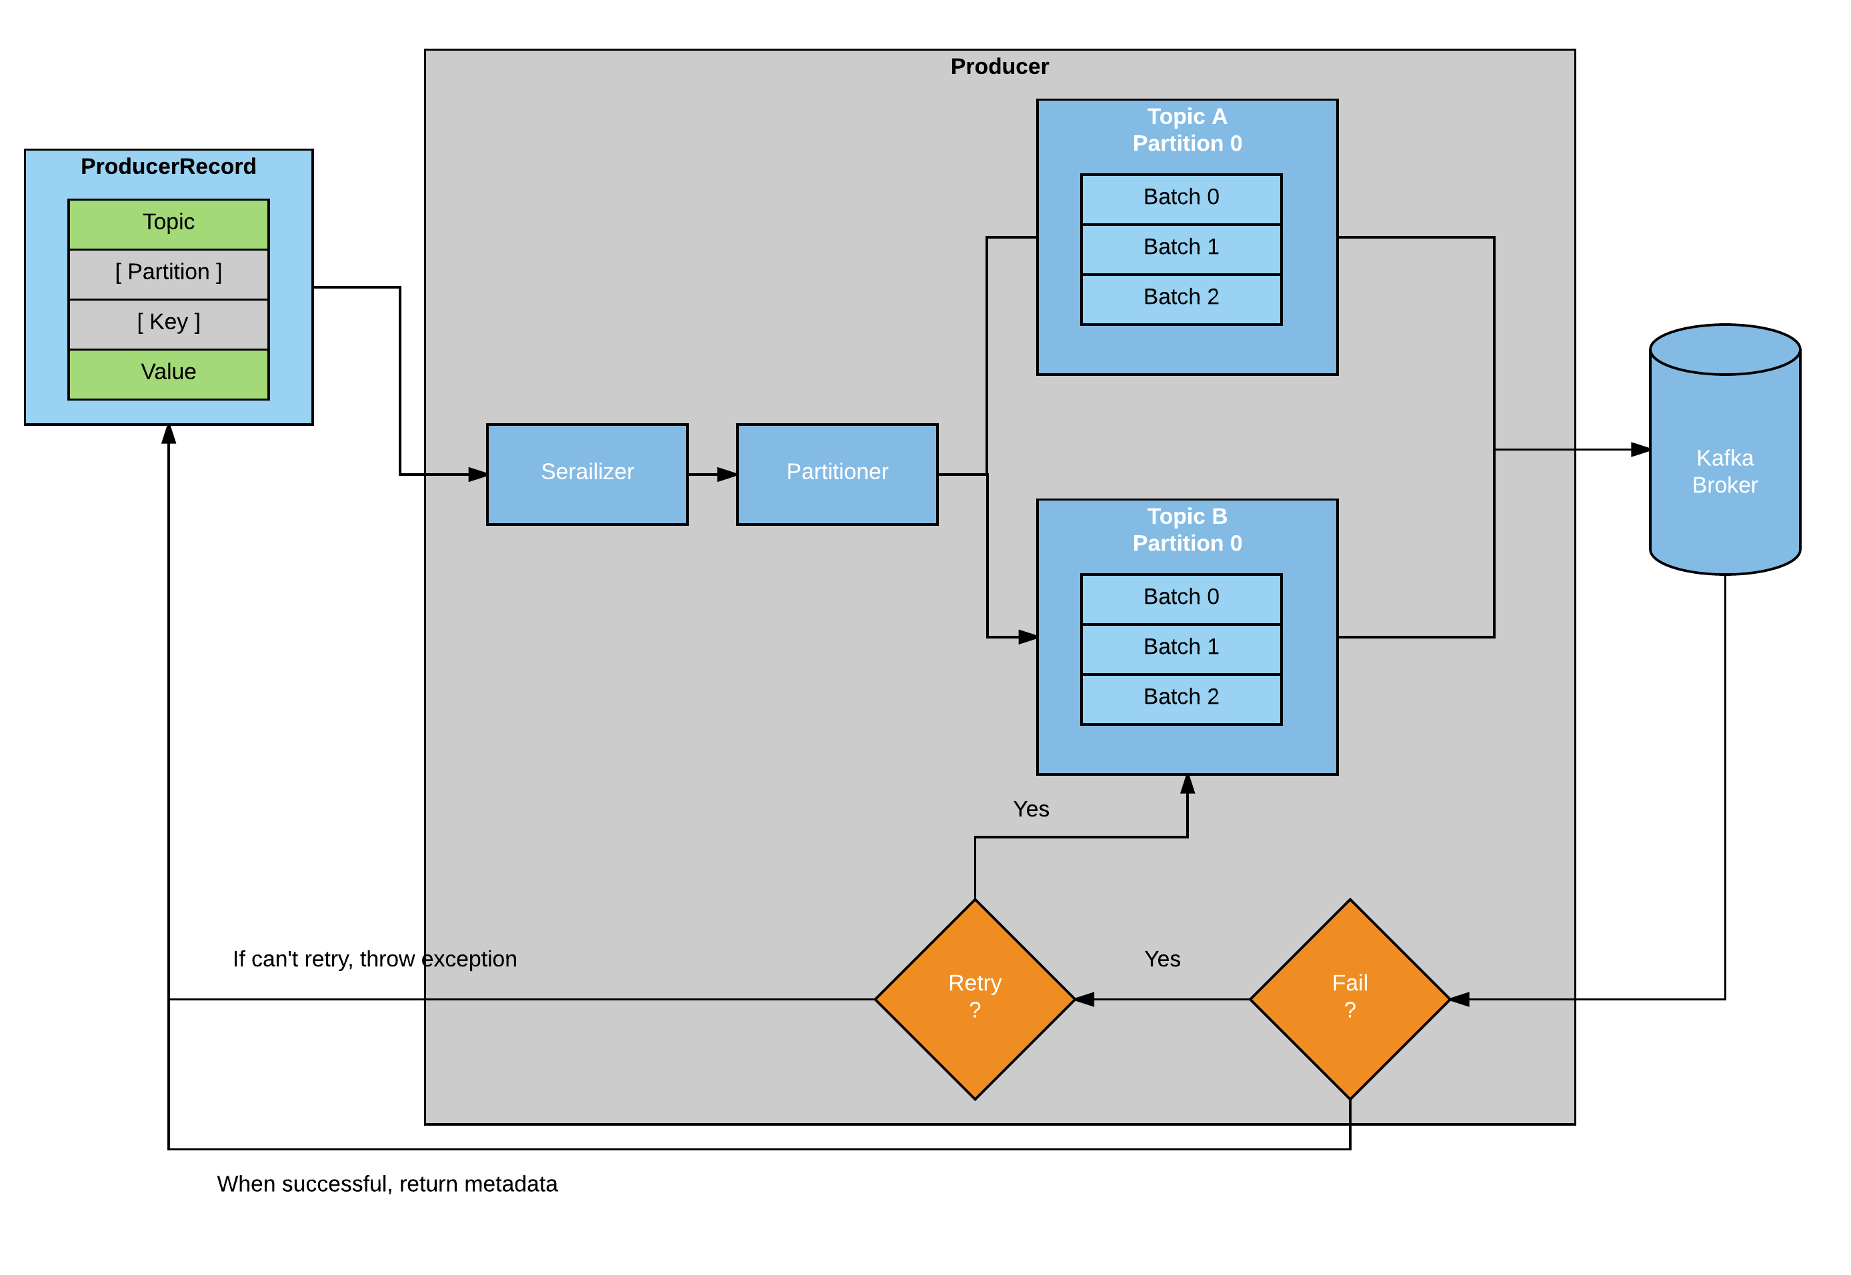
Producer Overview

Slide 16
Serialization
Kafka brokers receive byte arrays for keys and values of messages
The Kafka Producer interface allows any Java object as the key and value via parameterized types
This makes for very readable code but the Producer needs to know how to convert these objects to byte arrays!
Kafka includes a org.apache.kafka.common.serialization.Serializer interface that the Producer uses to serialize the object to byte array

Slide 17
Built-in Serializers
Kafka includes ByteArraySerializer, StringSerializer, and IntegerSerializer for common types
Using these built-in serializers is fine for simple values but eventually you will want to be able to serialize more generic types

Slide 18
Custom Serializers or Library
Eventually your application will probably need to send more complicated objects than Integers and Strings
Custom serializers
Can be hard to manage changes to serializer classes if new properties need to be added later
Debugging serializer issues is tedious (comparing byte arrays)
Apache Avro, Thrift, Protobuf are all well maintained serialization libraries that will solve many of the issues you will face writing a custom serializer
Use a serialization library unless you have a good reason not to!

Slide 19
Creating a Kafka Producer
Constructing a Kafka producer requires 3 mandatory properties
bootstrap.servers – list of host:port pairs of Kafka brokers. This doesn't have to include all brokers in the cluster as the producer will query about additional brokers. It is recommended to include at least 2 in case one broker goes down
key.serializer – should be set to a class that implements the Serializer interface that will be used to serialize keys
value.serializer - should be set to a class that implements the Serializer interface that will be used to serialize values

Slide 20
Message Partitioning
Kafka messages are key-value pairs
Keys serve two purposes
Additional information that gets stored with the message
Used to decide which one of the topic partitions the message will be written to
All messages with the same key go to the same partition
If a key is not specified, it will be set to null
If this occurs, the record will be sent to an available topic partition at random

Slide 21
Producer Configuration
There are many optional configuration parameters besides the three required (bootstrap.servers, key.serializer, value.serializer)
Most are fine to leave at default but a few can greatly affect performance

Slide 22
acks
Controls how many partition replicas must receive the record before the producer can consider the write successful
We discussed this earlier
Possible values:
0 → No acks
1..N → N replicas must acknowledge
-1 → All replicas must acknowledge

Slide 23
buffer.memory
Sets amount of memory the producer will use to buffer messages waiting to be sent to brokers

Slide 24
compression.type
By default, messages are sent uncompressed
This parameter can be one of gzip, snappy, or lz4 to compress messages before sending to the brokers
Enabling compression reduces network utilization

Slide 25
retries
If a producer receives an error message from the server, the value of retries will control how many times the producer attempts to send the message again
After the number of retries is exceeded, an error is returned to the client

Slide 26
batch.size
When multiple records are sent to the same partition, the producer batches them together
batch.size controls the amount of memory in bytes that will be used for each batch
When the batch is full, all messages in the batch will be sent
Producer does not necessarily wait for a batch to be full before sending!

Slide 27
linger.ms
Controls amount of time to wait before sending the current batch of messages
The producer sends a batch of messages either when the current batch is full or when linger.ms limit is reached
By default, producer sends messages as soon as the sender thread is available
By setting linger.ms, you increase latency but increase throughput because more messages are sent at once with less overhead per message

Slide 28
Summary
Producer API
Serialization
Custom serializer
Library
Message Partitioning
Producer Configuration

Slide 29
The Lab Explained
In this lab we'll develop a Java based message producer
After the next chapter, we'll have another lab to develop the consumer
The lab uses the docker setup to run Kafka
docker-compose up
Some editing may be required of the docker-compose file
We'll create a simple producer that:
Produces messages to two topics
100,000 messages into the 'user-events' topics
For every 100 messages, we'll produce a message to a 'global-events' topic
We are also using maven (please pair up with someone if you're not familiar with maven)

Slide 30
Lab Overview
Java Client
Docker Container
Kafka Producer
i : [1..100000]
write to user-events
if i % 100
write to global-events
Kafka Broker
user-events
Write
global-events
Zookeeper

Slide 31
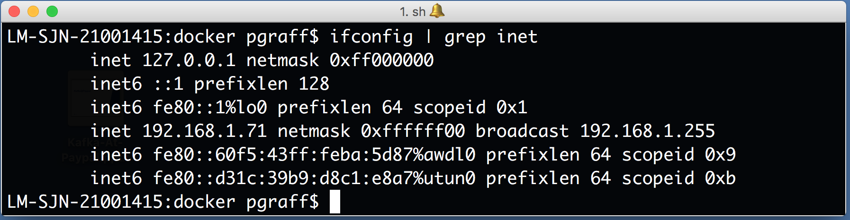
Step 1: Configure Your docker-compse.yml File
We need to configure the docker-compose.yml with the IP of your machine
To find the IP (ifconfig on the Mac, ipconfig on a Windows machine)

Slide 32
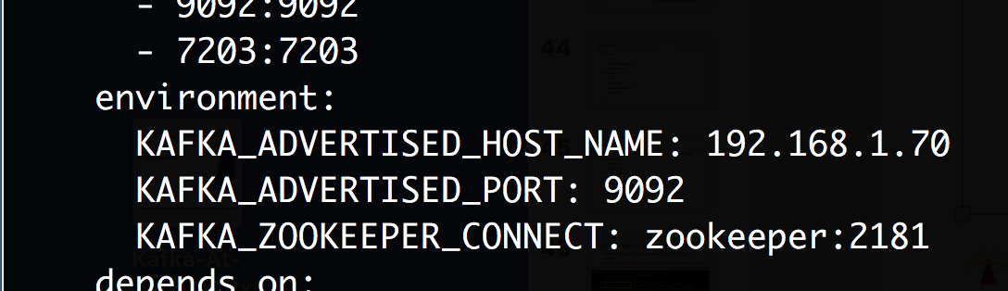
Step 2: Edit your docker-compose.yml file
Using your favorite editor, edit the docker-compose.yml file in the directory: kafka-labs/labs/02-Publish-And-Subscribe/docker
Look for the [insert] statement and replace it with your IP... E.g.:

Slide 33
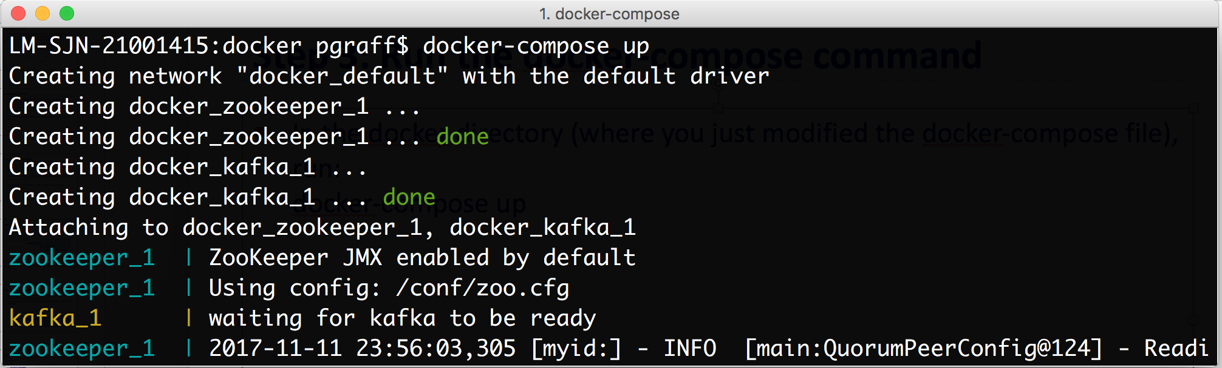
Step 3: Run the docker-compose command
In the docker directory (where you just modified the docker-compose file), run: docker-compose up

Slide 34
Step 4: Create the Topics
In a second terminal, cd into the directory kafka-lab/labs/02-Publish-And-Subscribe/docker
Create the two topics required for this exercise (user-event, global-events)
user-events
global-events

Slide 35
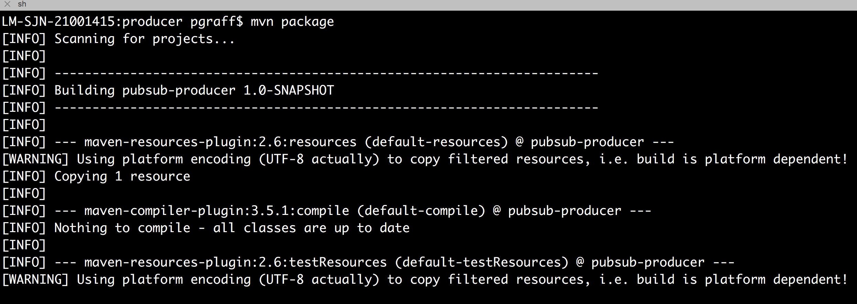
Step 5: Build the Producer
Use maven (either natively or using the docker image as described in the exercise description on GitHub)
Build using mvn package from the directory kafka-lab/labs/02-Publish-And-Subscribe/producer

Slide 36
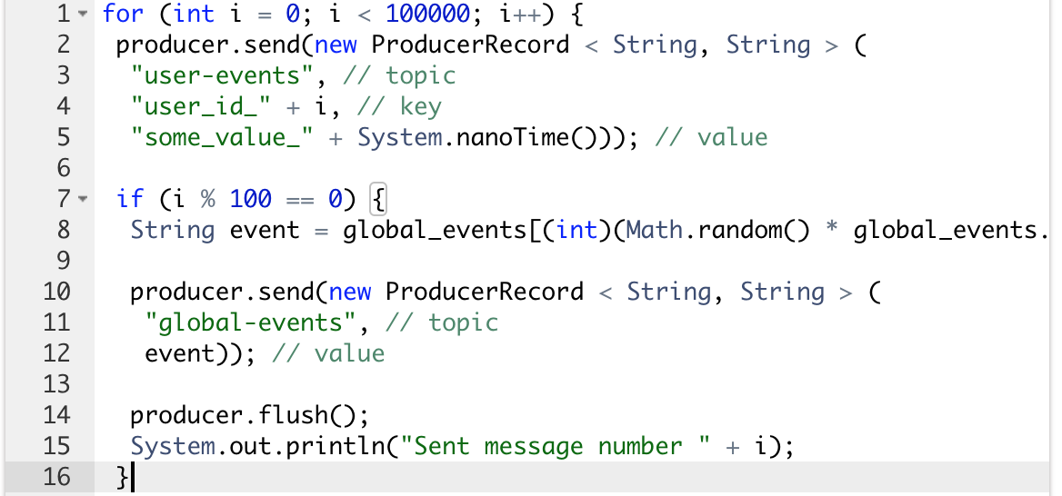
Producer Code

Slide 37
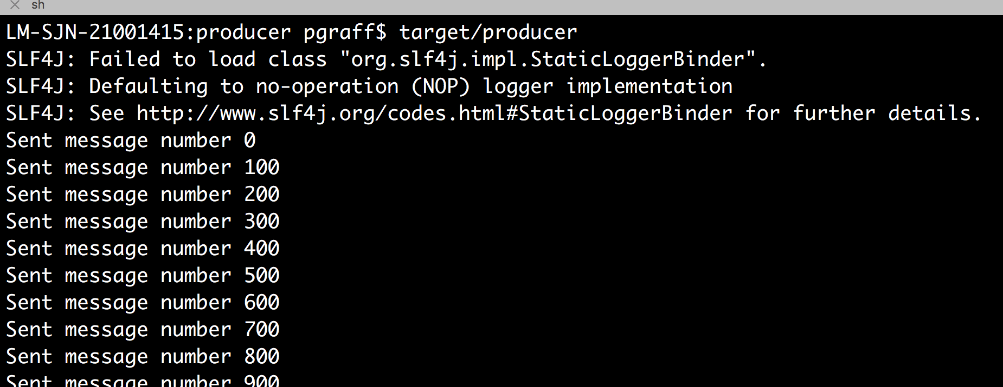
Step 6: Run the Publisher
The maven job creates a 'real executable' (target/producer)
We'll run the executable

